Slide 2
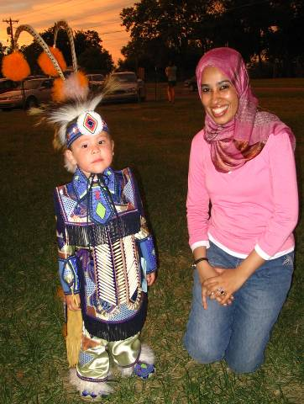
Building Global Community
by Connecting
People, companies, Families,
organizations and students
from Tulsa and
Oklahoma with the
Rest of the World.

Slide 3
Building Global Community by offering a World of Services
international visitors,
Sister Cities
exchanges, global
business programs
and global education

Slide 4
International Visitors
In 2020-2021 TGA hosted
---- International visitors from ---- countries
Involving…
24 Professional Meetings
5 Home hospitality dinners
Thank you, Tulsans!

Slide 5
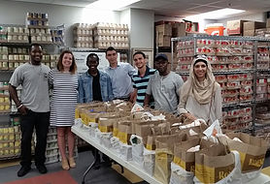
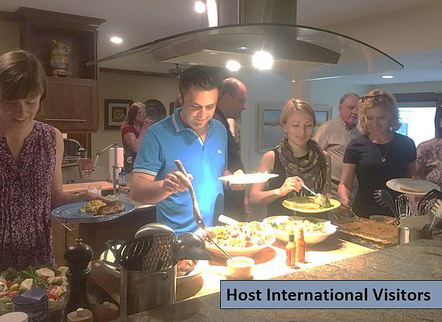
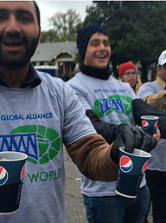
International Visitors – Volunteering and Hospitality

Slide 6
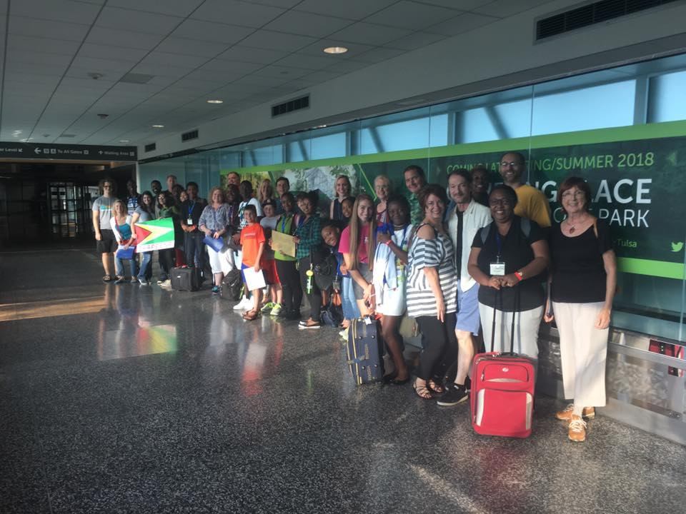
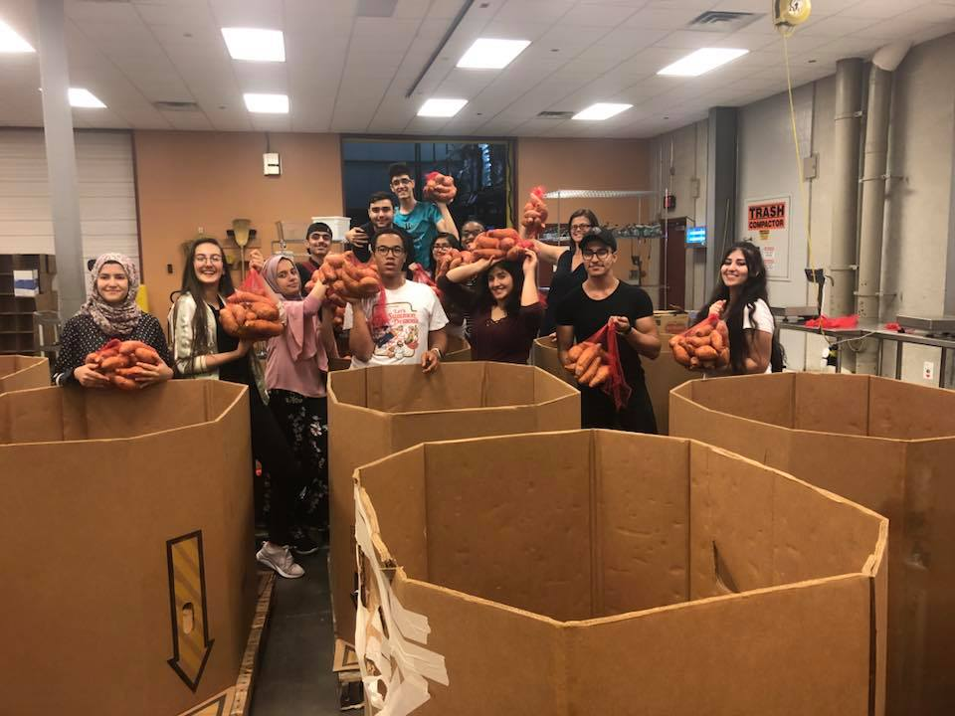
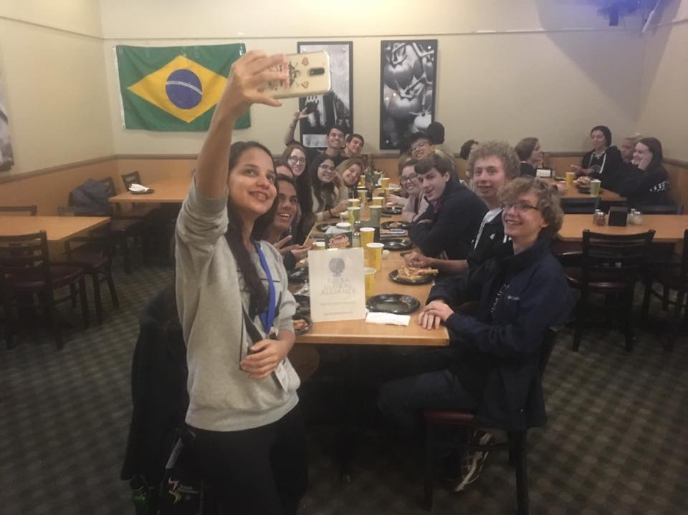
Youth Ambassadors Youth Leaders
In 2019, TGA hosted 36 participants in youth leadership programs representing 9 countries.

Slide 7
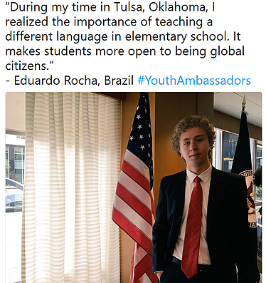

Slide 8
Sister Cities Display
At Tulsa International Airport
Amiens, France
Beihai, China
Celle, Germany Kaohsiung, Taiwan
San Luis Potosi, Mexico
Tiberias, Israel
Utsunomiya, Japan
Zelenograd, Russia
City Hall to City Hall, classroom to classroom, business to business, community to community and table to table.

Slide 9
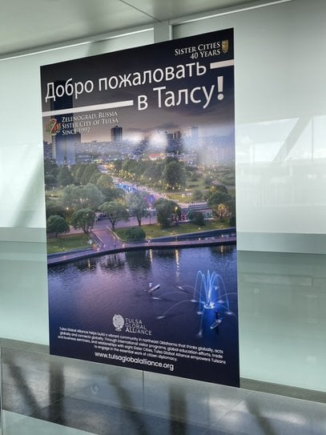
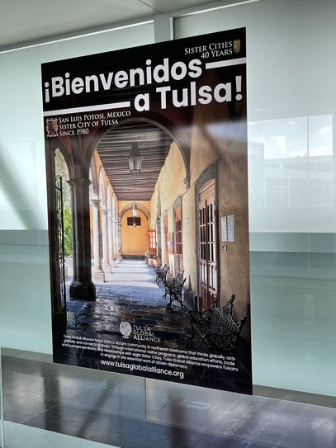
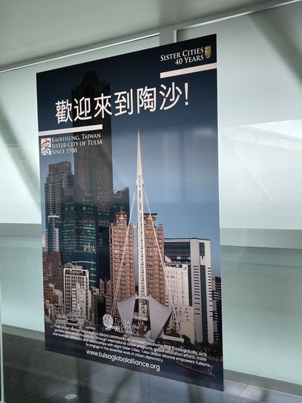
Sister Cities Display
At Tulsa International Airport

Slide 10
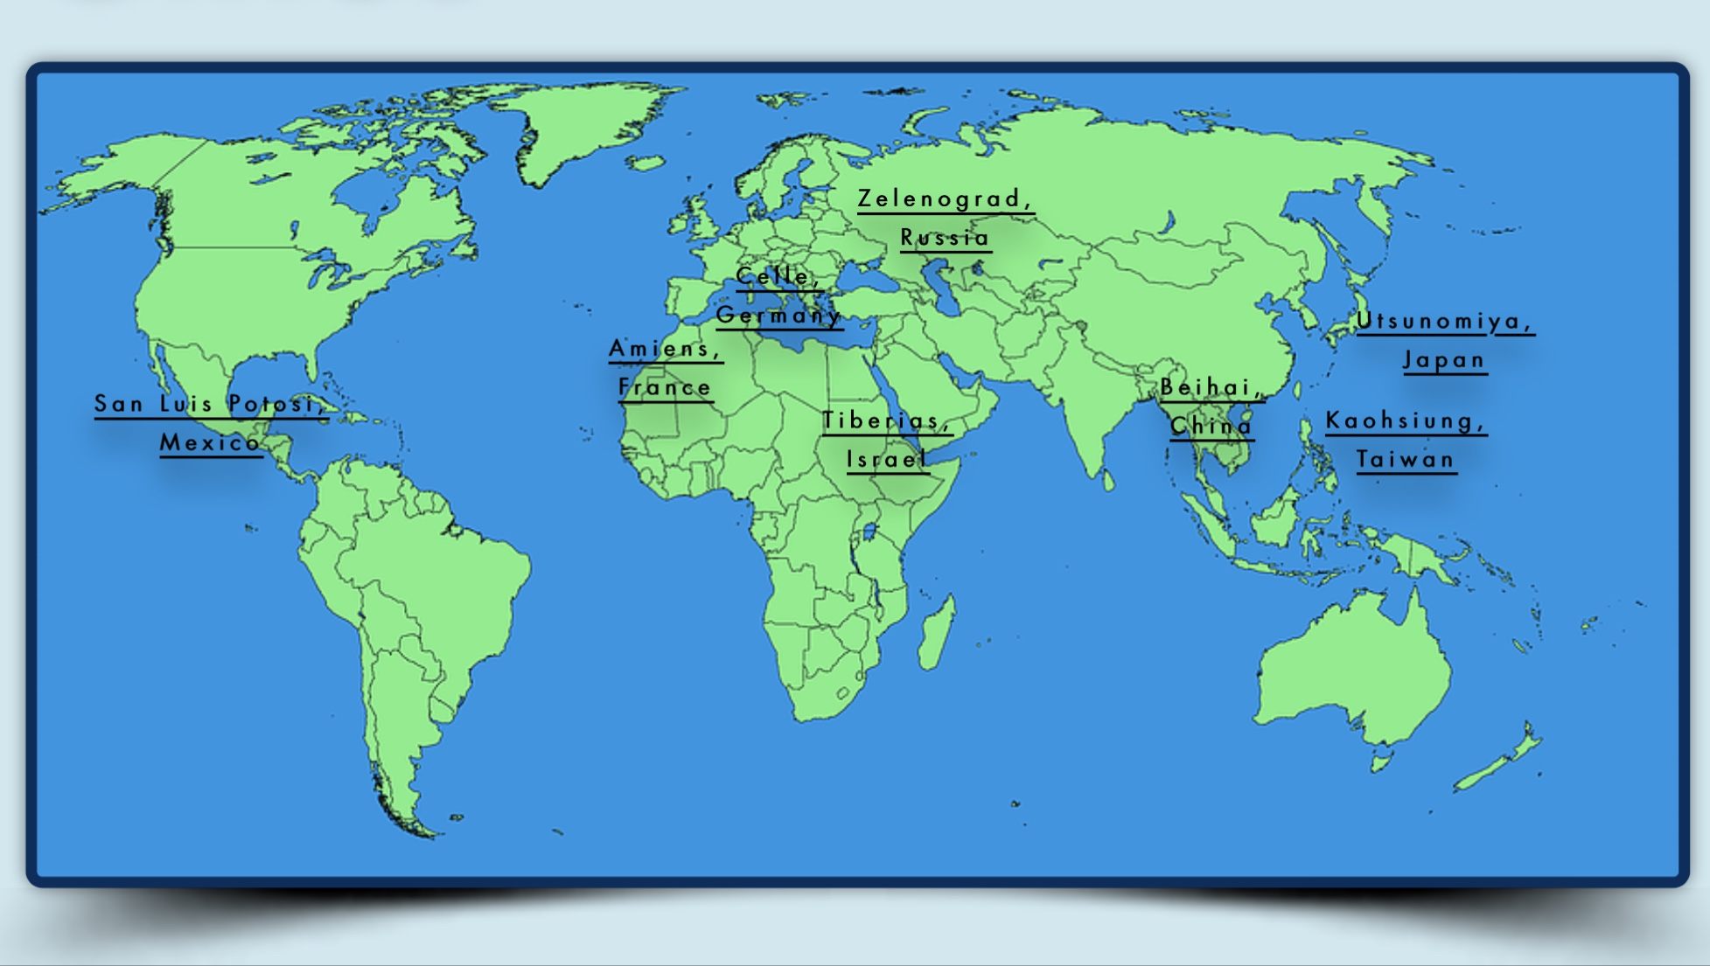

Slide 11
Tulsa Global Alliance has brought thousands of international visitors to our area through programs –sponsored by the U.S. Department of State Bureau of Educational and Cultural Affairs, the
U.S. Agency for International Development,
and the U.S. Library of Congress
Annual Economic Impact of TGA’s International visitors:
$641,390
Professional Visitor Programs
International Visitor Leadership Program &
Youth Ambassador Program
Funded by U.S. Department of State
Community Connections
Funded by USAID
Open World
Funded by Library of Congress

Slide 12
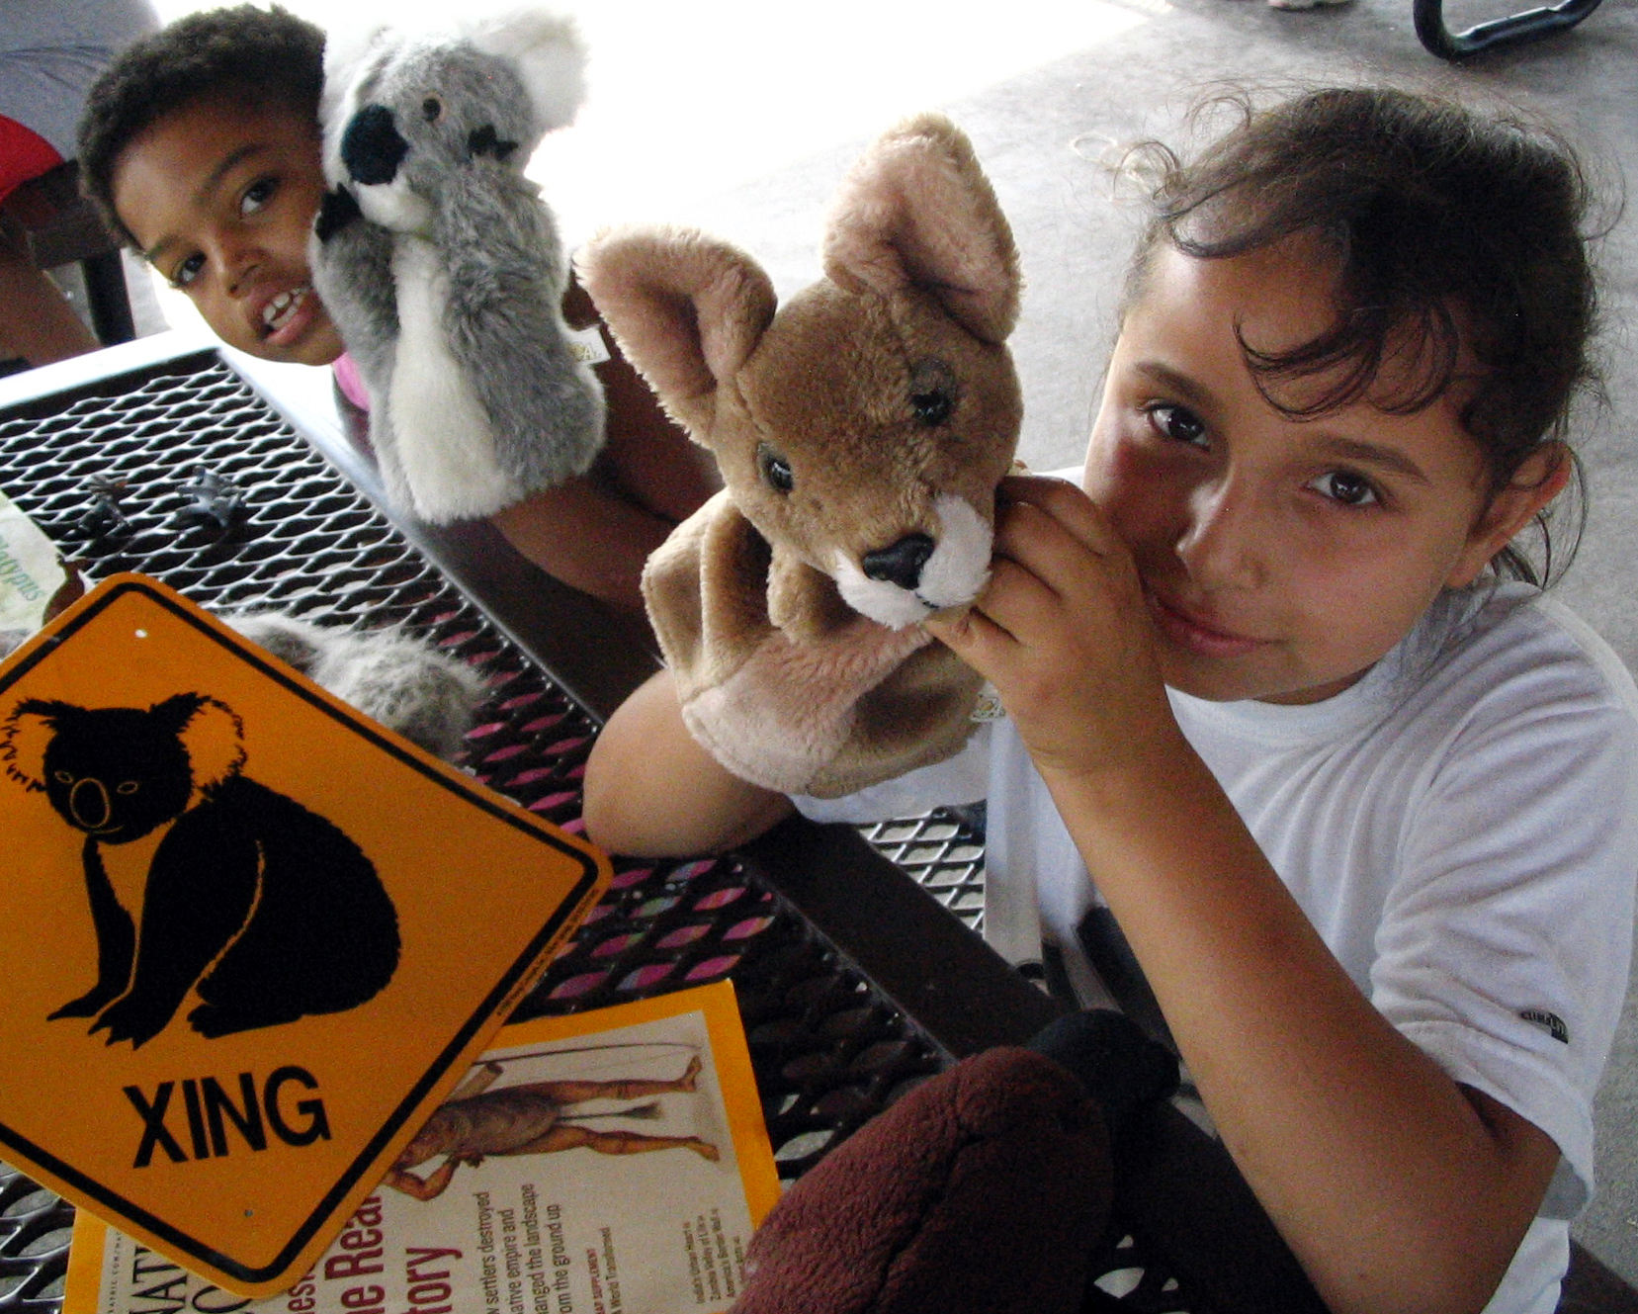
Global Education
“World in a Box Day”
….Tulsa City County Library Partner
Culture Box Program
Student/ Classroom Exchanges
….Tulsa Public Schools Partner
Collegiate International Partners
….TU, OSU, ORU, OU, TCC

Slide 13
Global Education-Tulsa City-County Library Build A Reader Sister Cities Storytimes
Eight videos with stories, greetings, and videos from the countries of Tulsa’s Sister Cities, with over 1,800 views from Tulsa and around the world!

Slide 14
The children we raise and teach will live in a world with transparent borders,
so intercultural competency is key to their education.

Slide 15
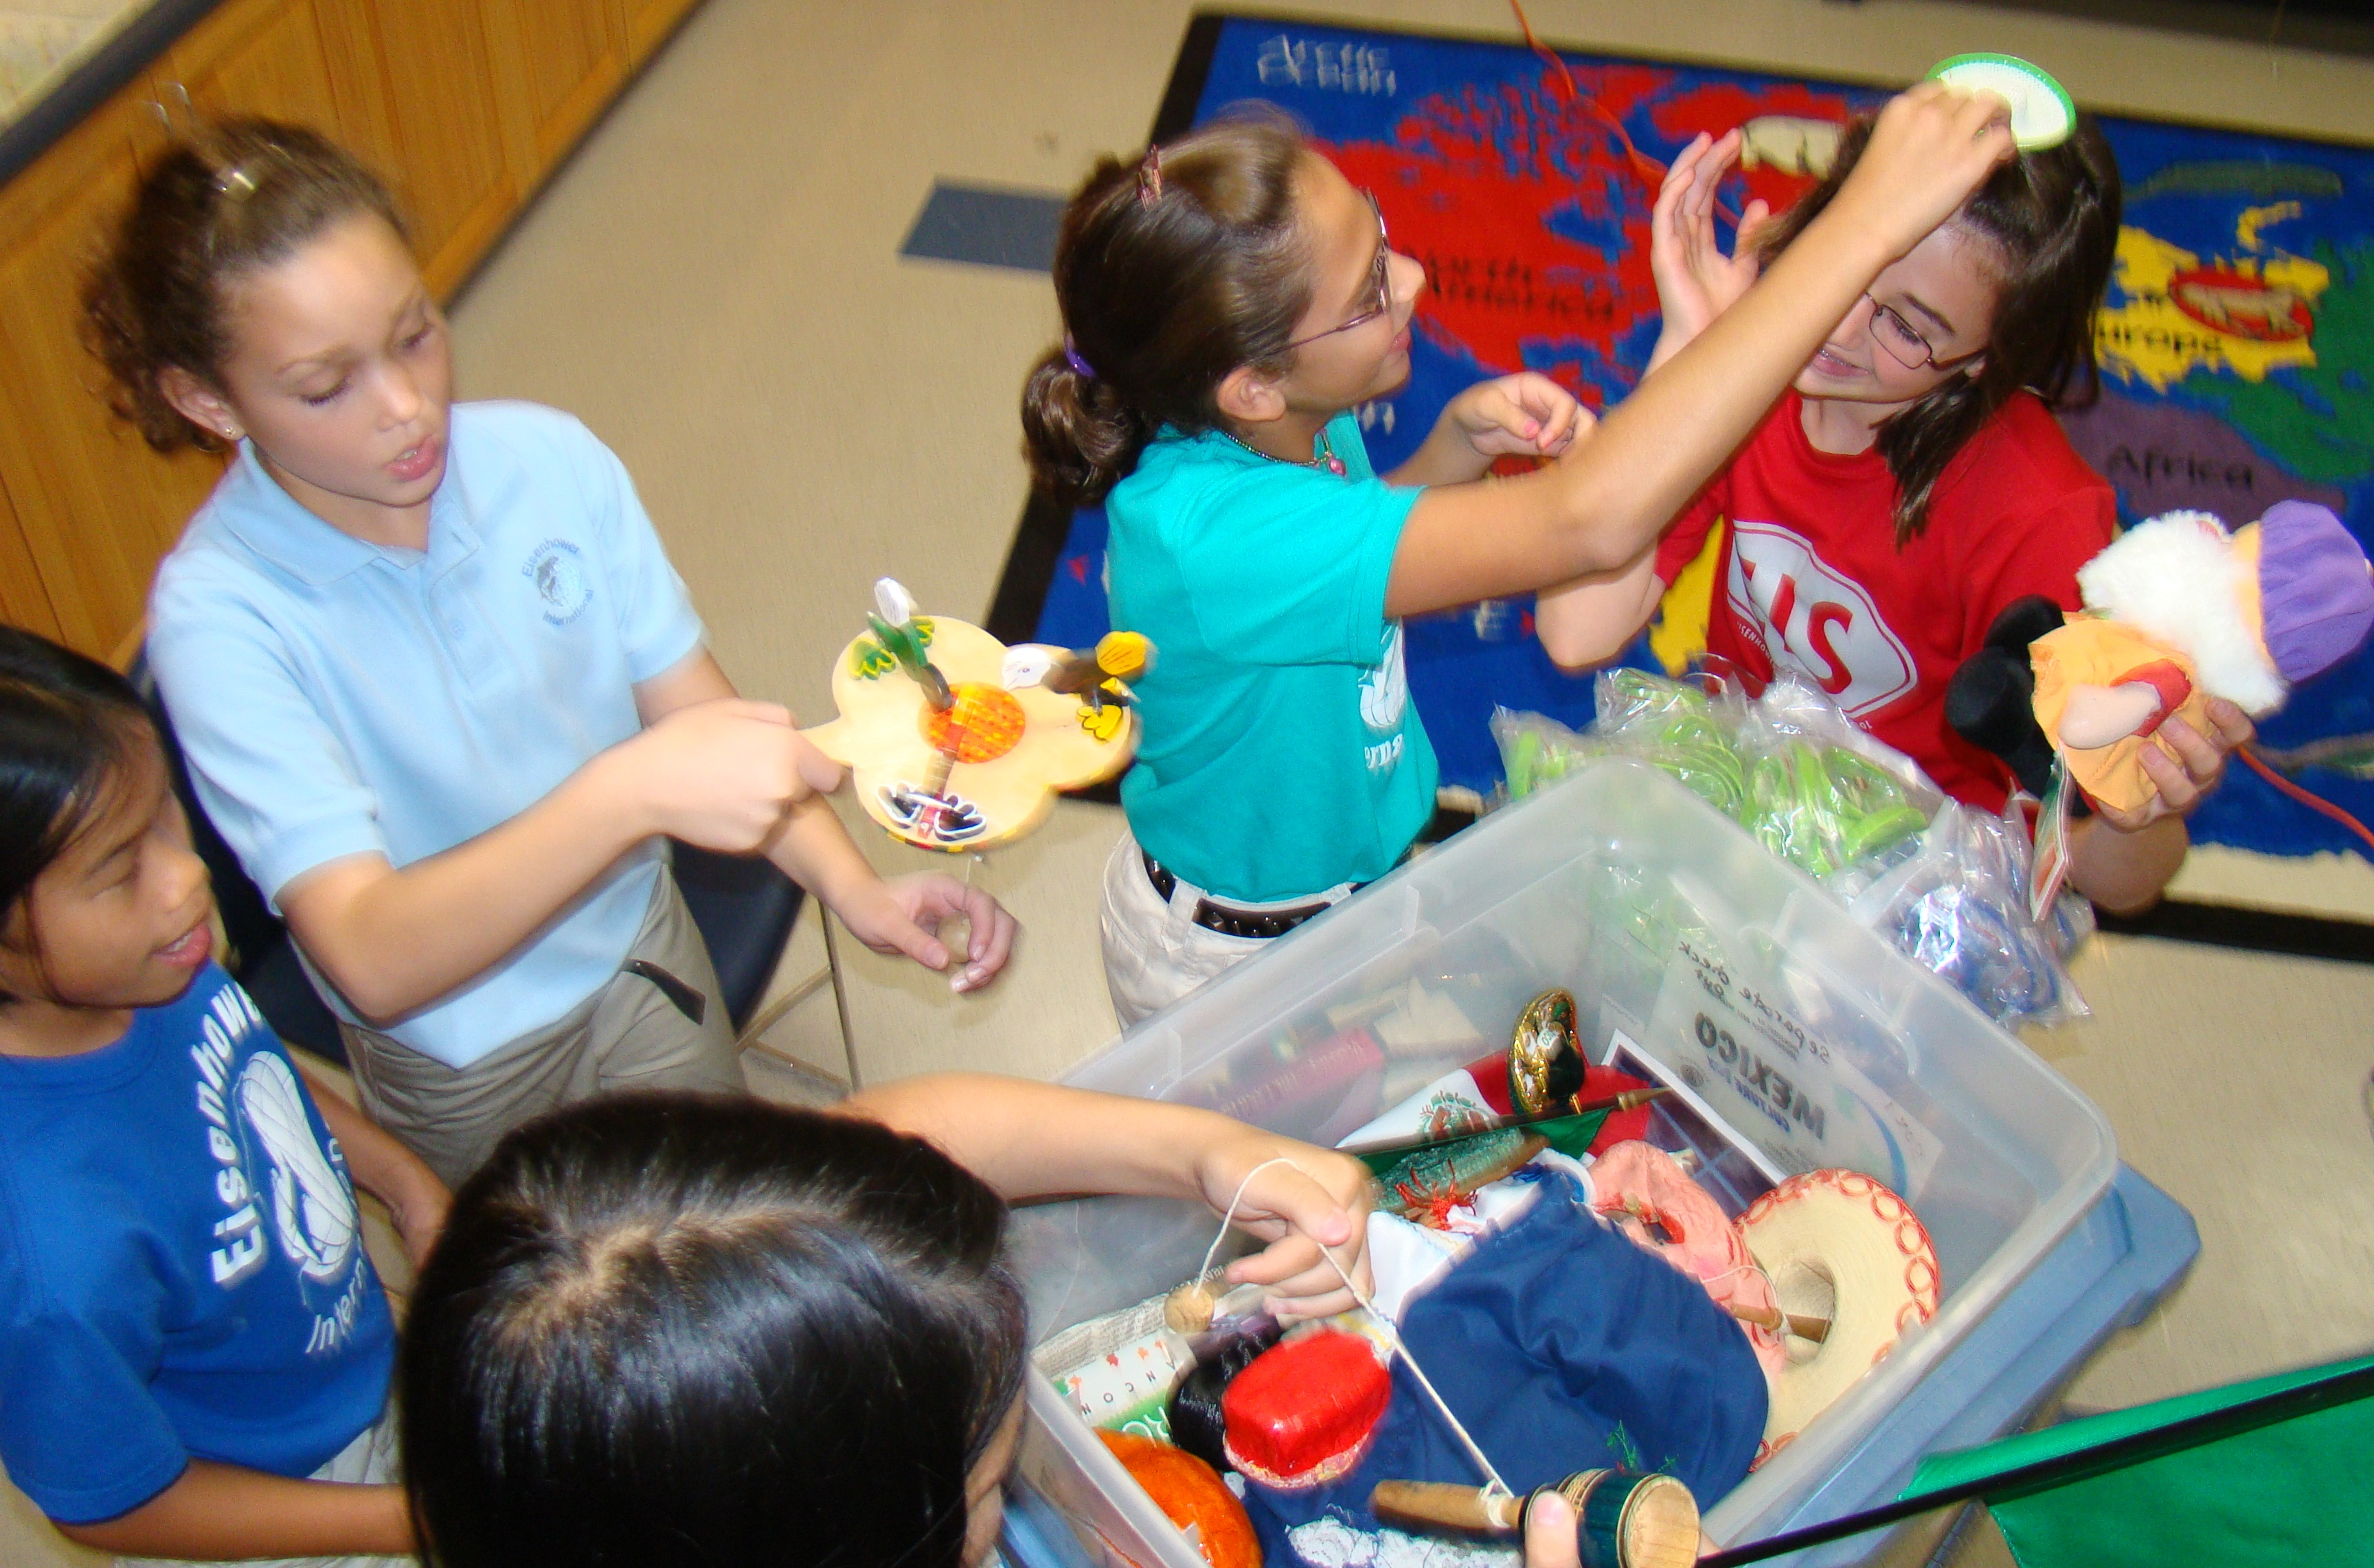
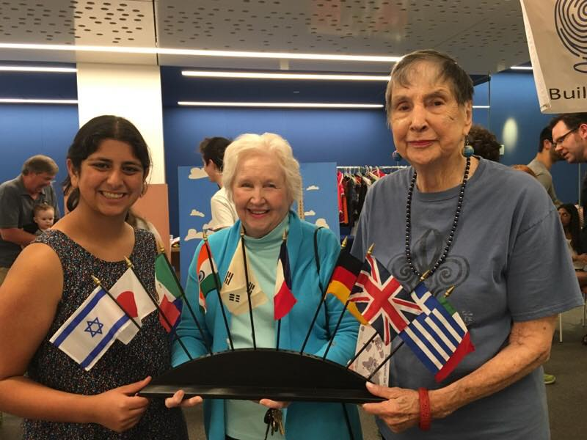
Culture Box Program
47 countries
hands-on learning
available for rent
See,
Touch,
Smell,
Hear
The World!

Slide 16
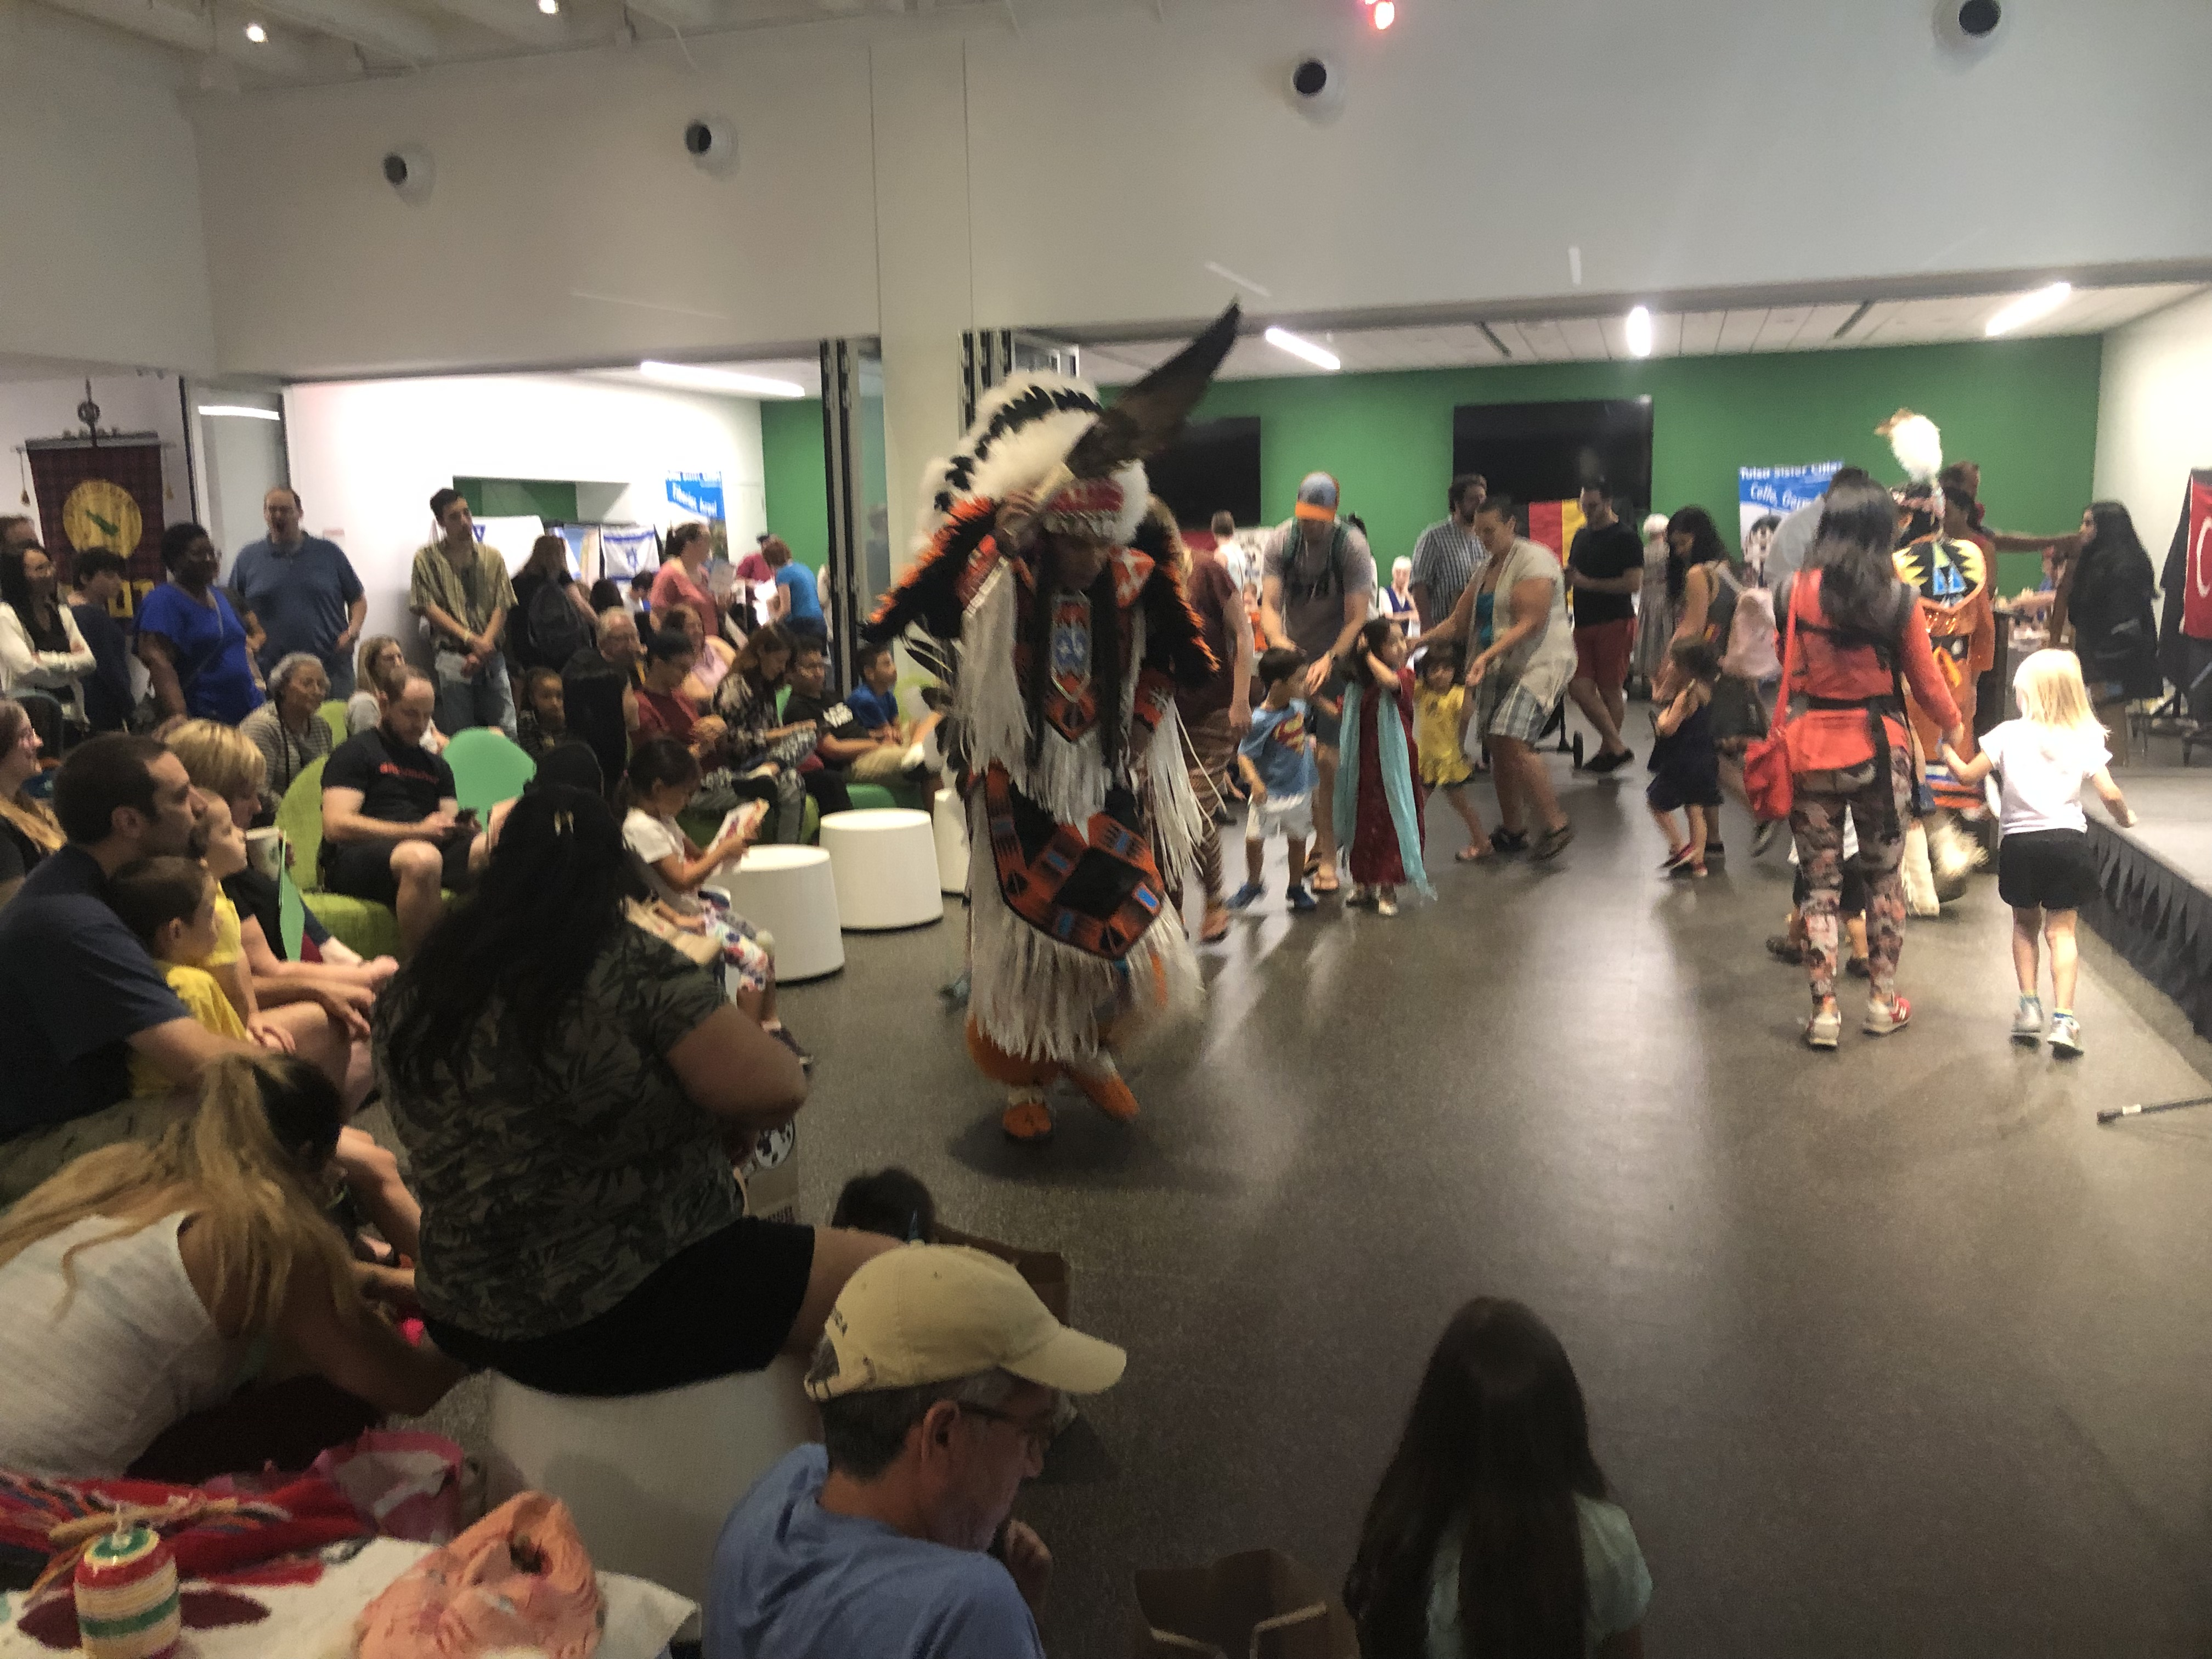
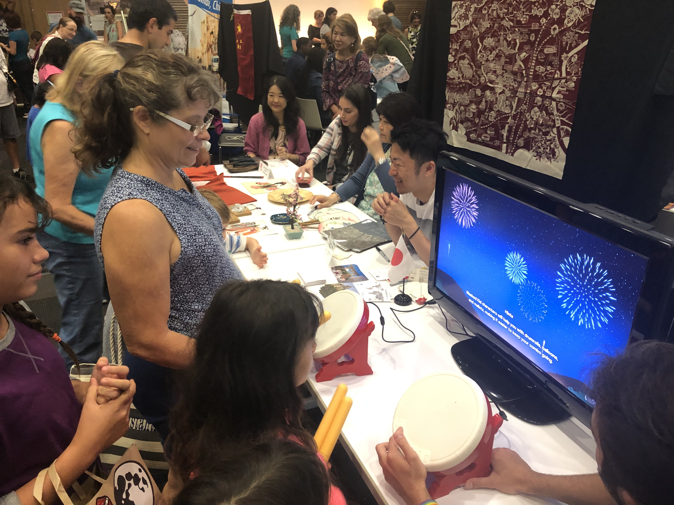
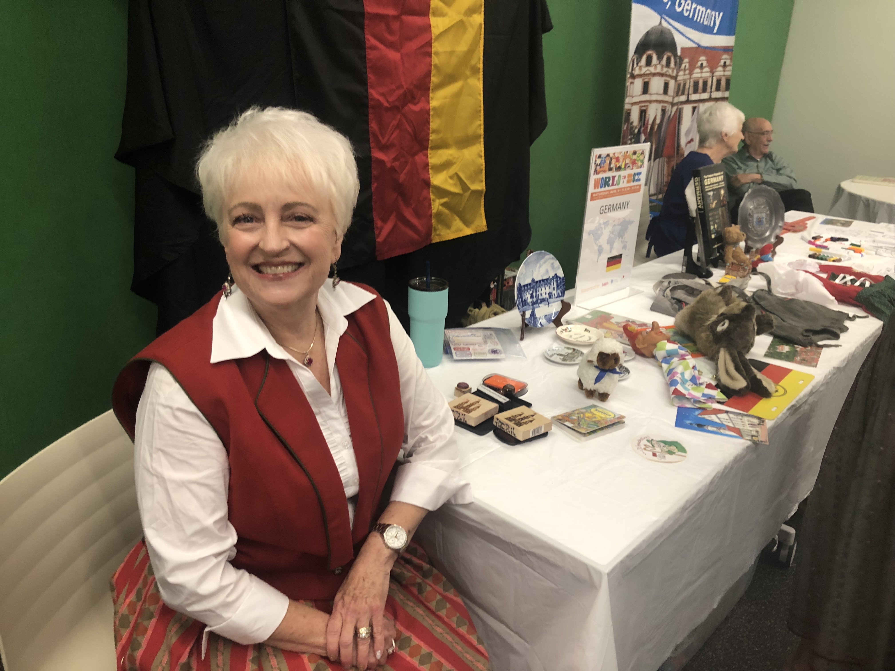
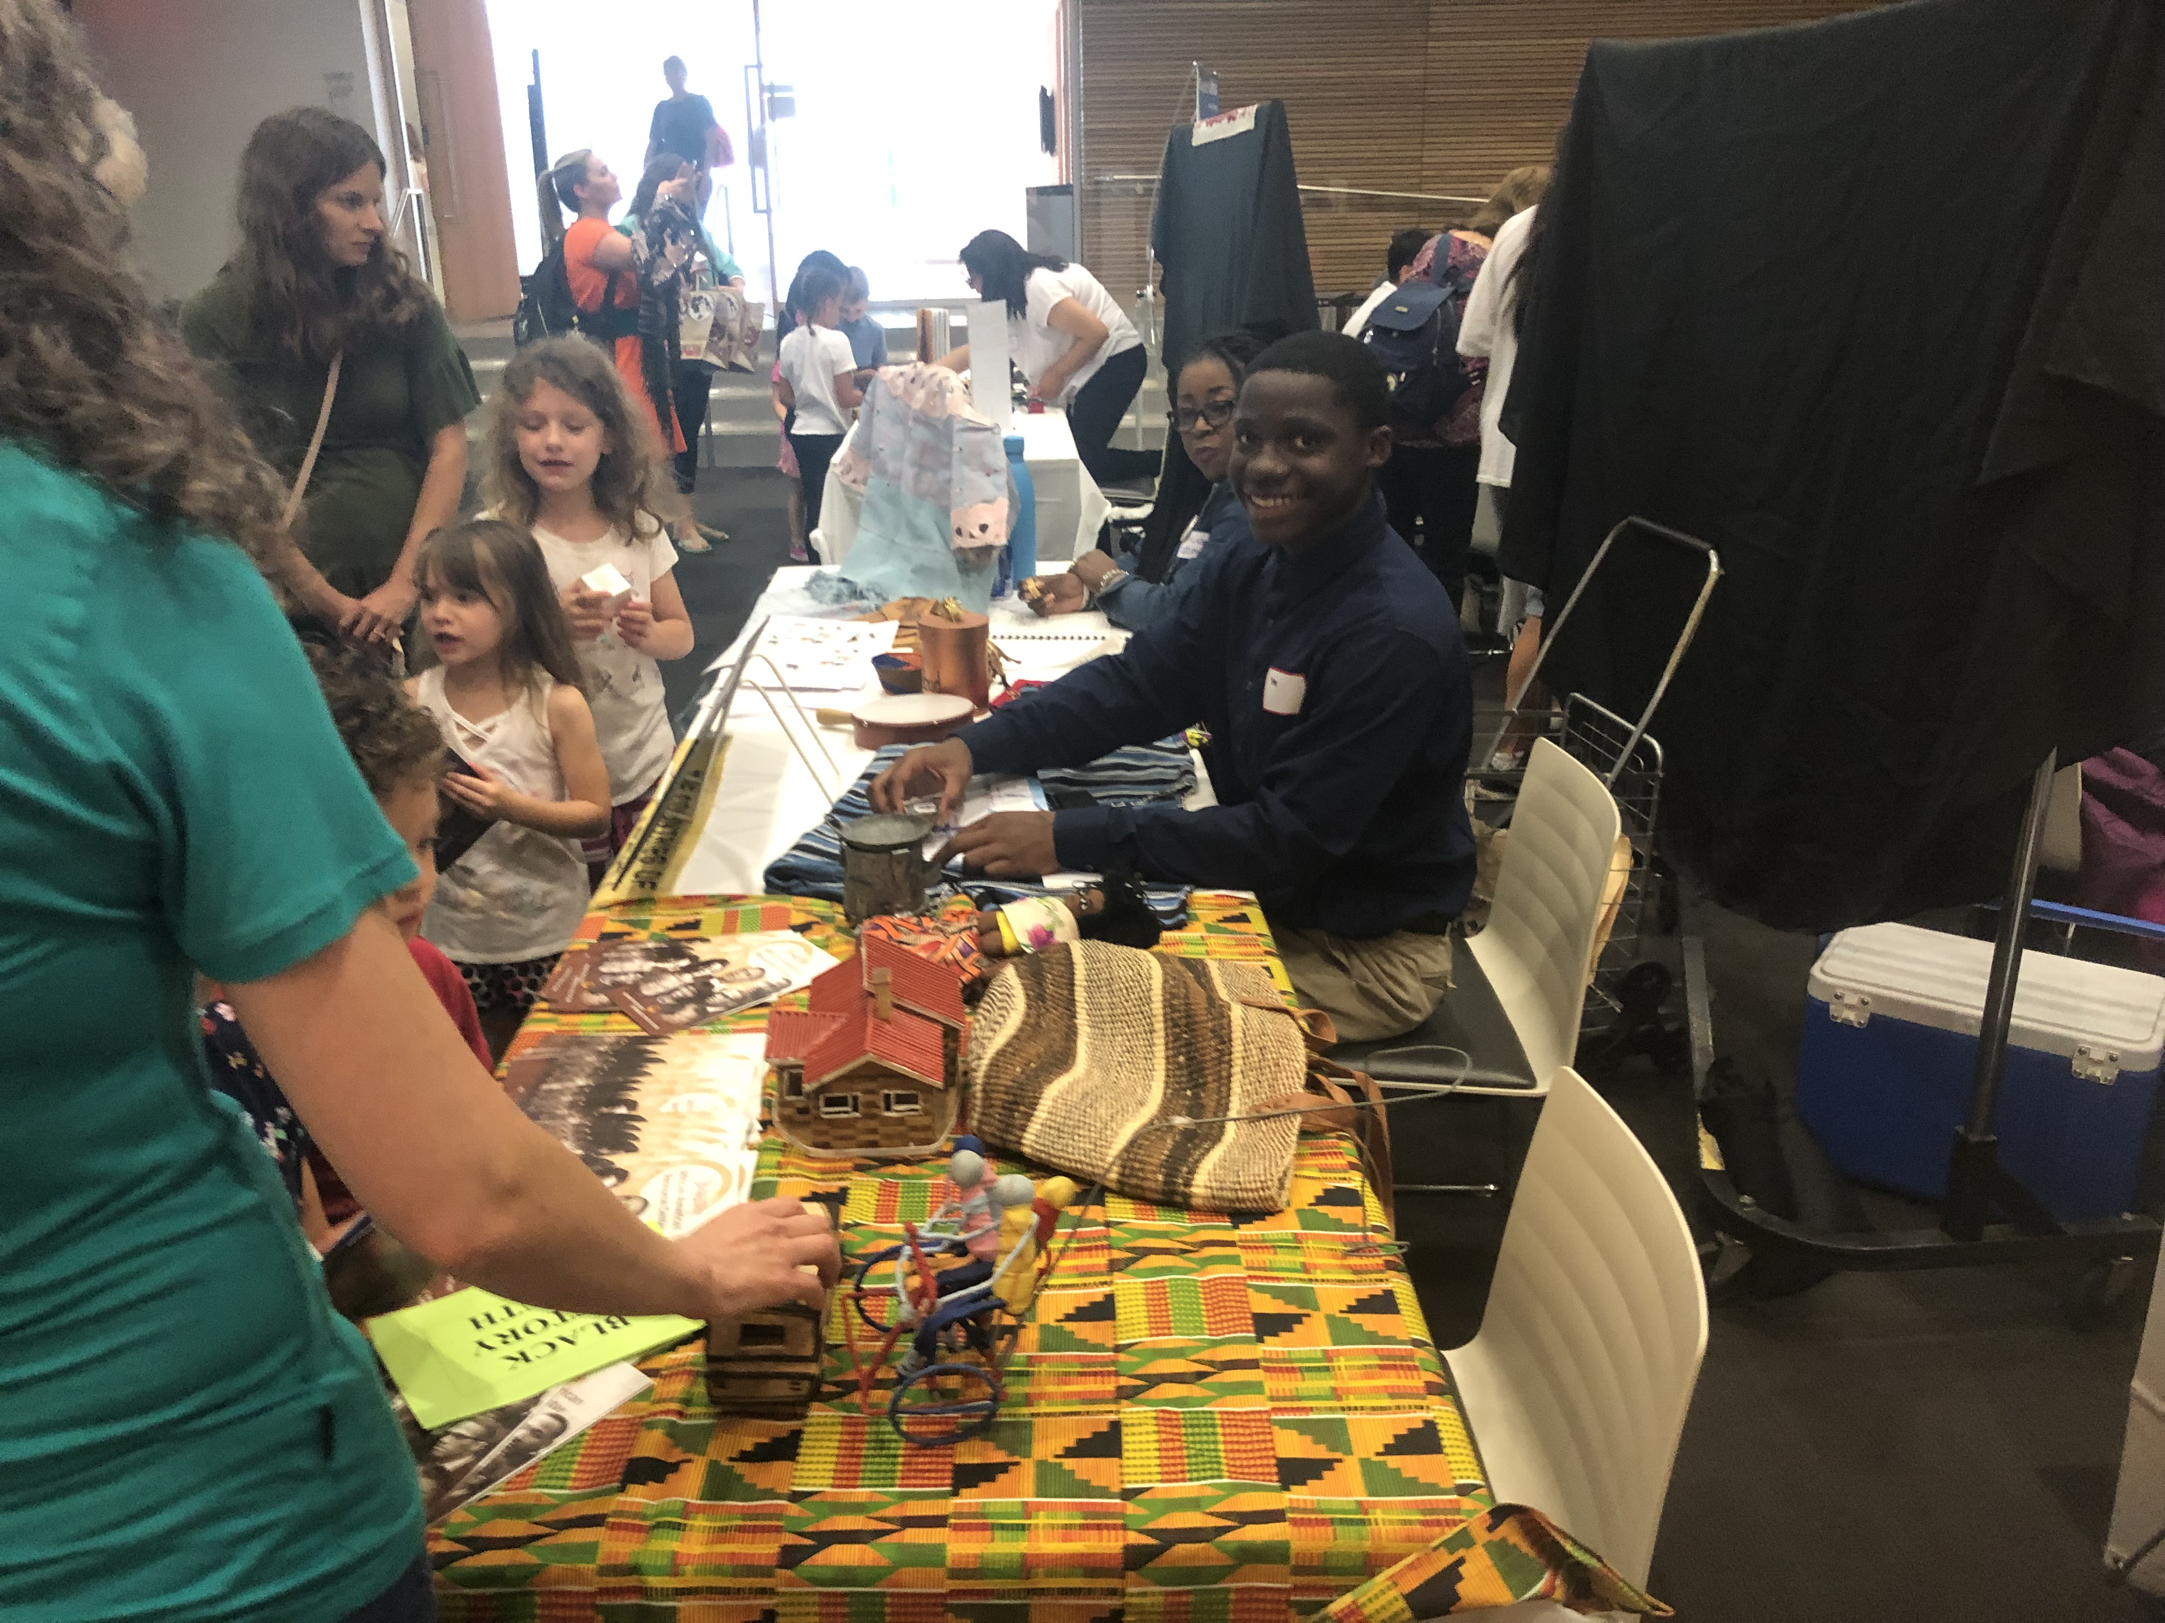
Photos from Our 2019
"World in a Box" Day!
1,000 people attended!
Thank you, Tulsa City-County Library for hosting! Thanks to the Gelvin Foundation for its sponsorship!

Slide 17
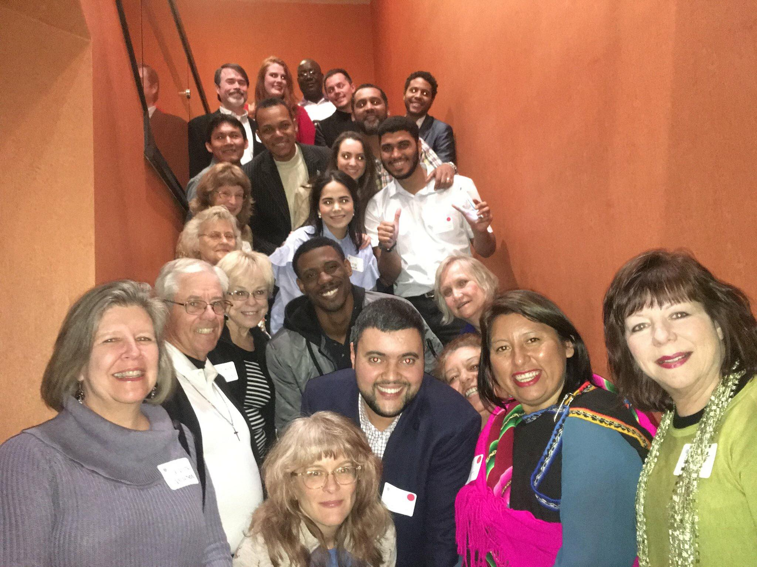
International Events
Toast the Travelers
Toast the Hosts
Trade/ Business Development Promotions
Savor! An International Food Tasting Event

Slide 18
Sample Tulsa's international restaurants!
Sin Fronteras (Central American)
India Palace
Jewish Federation of Tulsa
JINYA Ramen Bar
Kai Burmese
Lalibela Ethiopian Restaurant
Mr. Nice Guys (Costa Rican)
Margaret's German Deli & Restaurant
Que Gusto (Ecuadorian)
Raindrop Turkish House
Rendang & Co. (Indonesian) Bistro
Saint Amon Baking Company
Sisserou's
Tres Amigos
Zogam Cafe (Malaysian and Thai)
And... Marshall's Brewing Company!

Slide 19
TGA Corporate Partners
Empower their Companies for more global success while raising the community’s international awareness!

Slide 20
Corporate Partners/Sponsors
Visionary
OSU—Tulsa
Peacekeeper
Cherokee Nation Businesses
OSU School of Global Studies and Partnerships
T.D. Williamson
Emissary
Philip C. Lauinger, Jr.
RVA, LLC
Statesman
Commerce Bank
Helmerich & Payne, Inc.
Williams
Envoy
CCK Strategies
Gelvin Foundation
Magellan Midstream Partners
Charles and Lynn Schusterman Family Foundation
GableGotwals
Minister
Holiday Inn City Center
POSTOAK Lodge & Retreat
Tulsa Community College Foundation
Tulsa Port of Catoosa World Travel Service

Slide 21
Special Recognition
Community Partners
OSU Tulsa
The City of Tulsa
Circle Cinema
Greater Latin American Chamber of Commerce
Jewish Federation of Tulsa
Indo American Chamber of
Commerce of Oklahoma
Tulsa Community College
OU—Center for Studies in
Democracy & Culture
Philbrook Museum of Art
Raindrop Turkish House
Tyler Media
Tulsa Historical Society
Tulsa City County Library
Tulsa Public Schools
Tulsa Regional Chamber of Commerce
Union Public Schools

Slide 22
www.tulsaglobalalliance.org

